Slide 1
CUSTOMER SEGMENTATION PROJECT
Presented By:
Navya Sri Gongu
navyasrigongu@gmail.com

Slide 2
PROJECT OVERVIEW
This project focuses on analyzing customer demographics and purchasing behavior to identify distinct customer groups. Using K-Means Clustering, customers are segmented based on factors such as age, income, purchase amount, and purchase frequency. The segmented data is then visualized through an interactive Power BI dashboard to uncover valuable business insights.
Project Objectives
Analyze customer demographics and purchasing patterns.
Segment customers into meaningful groups using K-Means Clustering.
Identify high-value, regular, and budget customer segments.
Visualize customer segments and key metrics using Power BI.
Generate data-driven recommendations for targeted marketing and customer retention.

Slide 3
PROBLEM STATEMENT:
Businesses often have a diverse customer base with varying demographics, purchasing behaviors, and spending patterns. Treating all customers the same can lead to ineffective marketing campaigns, lower customer satisfaction, and missed revenue opportunities.
The challenge is to identify meaningful customer groups based on their behavior and characteristics so that businesses can better understand customer needs, improve customer engagement, and develop targeted marketing strategies.
This project addresses the problem by applying K-Means Clustering to segment customers using factors such as age, income, purchase amount, and purchase frequency. The resulting customer segments help businesses make data-driven decisions, optimize marketing efforts, and enhance customer retention and profitability.

Slide 4
DATASET DESCRIPTION
The dataset contains customer demographic and purchasing information used to perform customer segmentation. It helps identify different customer groups based on their spending behavior and purchase frequency.
Dataset Summary
Dataset Name: Customer Segmentation Dataset
Total Records: 50 Customers
Total Features: 6 Attributes
Data Type: Structured CSV Dataset

Slide 5
Features Description
Feature | Description
Age | Age of the customer
CustomerID | Unique identifier for each customer
Gender | Gender of the customer (Male/Female)
Income | Annual income of the customer
PurchaseAmount | Total amount spent by the customer
PurchaseFrequency | Number of purchases made by the customer

Slide 6
Key Characteristics
Contains both demographic and behavioral data.
Includes customers from different income groups.
Captures spending habits and purchasing frequency.
Suitable for clustering and customer segmentation analysis.
Supports business decision-making through customer insights

Slide 7
DATA PREPROCESSING
Data preprocessing is an essential step to prepare the dataset for customer segmentation. It ensures that the data is clean, consistent, and suitable for machine learning algorithms.
Steps Performed
1. Data Collection
Imported the customer dataset from a CSV file.
Loaded the data into a Pandas DataFrame for analysis.
2. Data Inspection
Examined the dataset structure using head(), info(), and describe().
Verified data types and feature availability.

Slide 8
3. Missing Value Handling
Checked for null or missing values.
Filled missing numerical values using appropriate statistical methods if required.
4. Duplicate Removal
Identified and removed duplicate customer records to improve data quality.
5. Feature Selection
Selected relevant features for clustering:
Age
Income
Purchase Amount
Purchase Frequency
Excluded:
CustomerID (Identifier)
Gender (Not used for clustering in this project)

Slide 9
6. Data Standardization
Applied StandardScaler to normalize numerical features.
Ensured all variables contribute equally to clustering.
7. Data Preparation for Clustering
Created a feature matrix containing selected attributes.
Prepared the dataset for K-Means Clustering.
Tools Used
Pandas
NumPy
Scikit-Learn (StandardScaler)

Slide 10
K-MEANS CLUSTERING
K-Means Clustering is an unsupervised machine learning algorithm used to group similar customers into distinct segments based on their characteristics and purchasing behavior. It helps businesses understand customer patterns and create targeted marketing strategies.
Why K-Means?
Simple and efficient clustering technique.
Groups customers with similar behavior.
Helps identify high-value and low-value customer segments.
Supports data-driven business decisions.

Slide 11
Steps Involved
1. Feature Selection
Selected important customer attributes:
Age
Income
Purchase Amount
Purchase Frequency
2. Data Standardization
Applied StandardScaler to normalize the data and ensure equal contribution of all features.
3. Determine Optimal Clusters
Used the Elbow Method to find the optimal number of clusters (K).

Slide 12
4. Apply K-Means Algorithm
The algorithm:
Randomly initializes cluster centroids.
Assigns customers to the nearest centroid.
Recalculates centroids based on assigned customers.
Repeats until clusters stabilize.
5. Generate Customer Segments
Customers were grouped into 4 distinct clusters based on their purchasing behavior and income levels.

Slide 13
CUSTOMER SEGMENTS
After applying K-Means Clustering, customers were grouped into four distinct segments based on their income, spending habits, and purchase frequency. Each segment represents customers with similar characteristics and behaviors.
Cluster 0 – Budget Customers
Characteristics
Low income levels
Low purchase amounts
Less frequent purchases
Price-sensitive customers
Business Strategy
Offer discounts and promotional deals
Introduce budget-friendly products
Use coupon-based marketing campaigns

Slide 14
Cluster 1 – Regular Customers
Characteristics
Moderate income
Consistent purchasing behavior
Average spending patterns
Stable customer base
Business Strategy
Provide personalized recommendations
Offer loyalty points and rewards
Maintain customer engagement through regular promotions

Slide 15
Cluster 2 – Premium Customers
Characteristics
High income levels
High purchase amounts
Frequent purchases
Strong purchasing power
Business Strategy
Promote premium products and services
Provide exclusive offers and memberships
Focus on customer retention programs

Slide 16
Cluster 3 – VIP Customers
Characteristics
Very high income
Highest spending levels
Most frequent purchases
Most valuable customer segment
Business Strategy
Offer VIP memberships and priority services
Provide personalized support
Launch exclusive premium campaigns

Slide 17
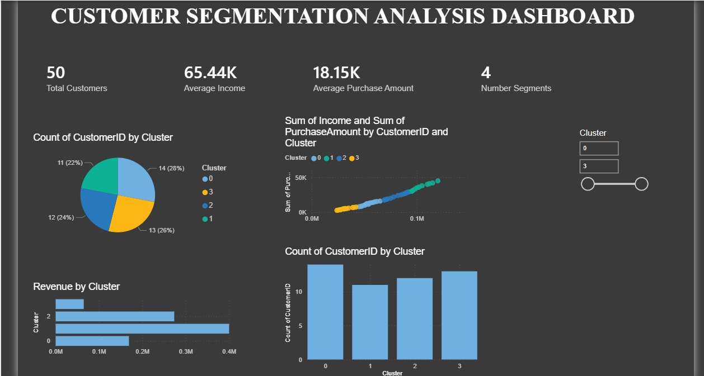
DASHBOARD

Slide 18
KEY INSIGHTS
Successfully segmented customers into four meaningful groups using K-Means Clustering.
VIP Customers generated the highest revenue and purchase frequency. Premium Customers showed strong spending potential and customer value.
Regular Customers provided stable and consistent sales contributions.
Budget Customers were more price-sensitive and responsive to promotions.
Income and spending behavior played a key role in customer segmentation.
Customer segmentation enables targeted marketing and improved customer retention.
Power BI visualizations helped uncover valuable customer insights and business opportunities.

Slide 19
CONCLUSION
This project successfully applied K-Means Clustering to segment customers based on their demographics and purchasing behavior. By analyzing factors such as age, income, purchase amount, and purchase frequency, customers were grouped into meaningful segments including Budget, Regular, Premium, and VIP Customers.
The segmentation process helped identify customer spending patterns, high-value customer groups, and potential business opportunities. An interactive Power BI dashboard was developed to visualize customer insights, monitor segment performance, and support data-driven decision-making.
Overall, the project demonstrates how customer analytics and machine learning can help businesses improve marketing effectiveness, enhance customer retention, and maximize revenue through targeted strategies.

Slide 20
FUTURE SCOPE
Use larger real-world datasets for deeper analysis.
Implement predictive models for customer behavior forecasting.
Develop personalized recommendation systems.
Enable real-time customer segmentation and monitoring.

Slide 21


